Slide 1
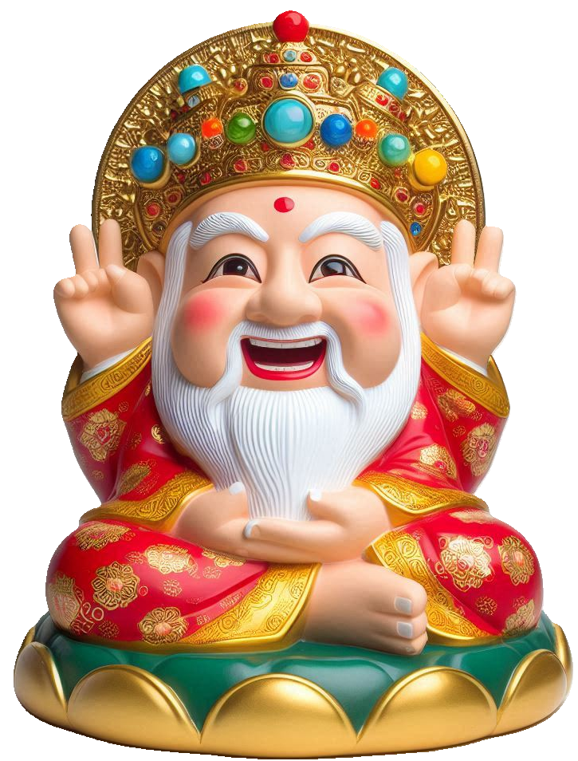
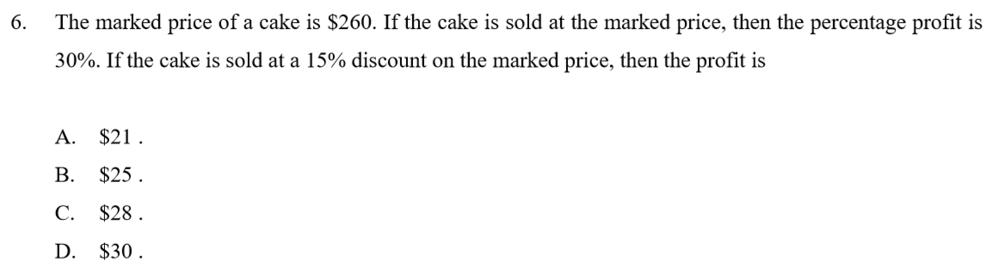
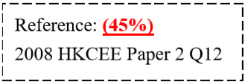
























1
CMDSP
2
$$+$$
30%
3
15%
OFF
4
5
Cost
Marked Price
Discount
Selling Price
Profit
C
M
$ 260
D
S
P
$$=$$
S
$$−$$
C
C
(1
$$+$$
$$=$$
(1
$$−$$
15%)
S
$$=$$
260
(1
$$−$$
15%)
30%)
260
一成本二標價，三折四售，五倍利潤笑哈哈
Growth Rate
$$+$$
50%
Decay Rate
$$−$$
15%
Growth Factor
(1
$$+$$
50%)
Decay Factor
(1
$$−$$
15%)
2
2
4
3
5
1
C
Let be the cost of the cake.
3
2
C
(1
$$+$$
$$=$$
30%)
260
4
S
$$=$$
260
(1
$$−$$
15%)
C
$$=$$
200
S
$$=$$
221
5
P
$$=$$
S
$$−$$
C
P
$$=$$
221
$$−$$
200
$$=$$
$ 21

Slide 2











Percentage Constant Rate
Old value
Change factor
New Value
Example
1000
$+$10%
x
$$=$$
1000
$$×$$
(1
$$+$$
10%)
New Value
$$=$$
1100
Old value
n
Change factor
New Value
Example
10000
$+$10%
x
Value change yearly
Starting time$:$ Beginning of 2021
$$=$$
5
n
Ending time$:$ The end of 2025
$$×$$
(1
$$+$$
5
$$=$$
10%)
New Value
10000
$$=$$
14641

Slide 3






Old value
n
Change factor
New Value
Example
x
$+$10%
9680
Value change yearly
Starting time$:$ Beginning of 2021
$$=$$
n
2
Ending time$:$ The end of 2022
2
x
(1
$$+$$
$$=$$
9680
10%)
2
x
$$=$$
9680
(
1.1)
x
$$=$$
8000
The Old value is 8000.

Slide 4
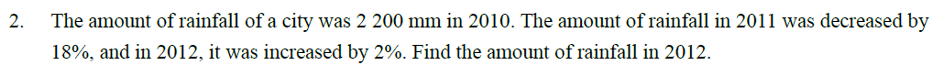














Amount of rainfall in 2012
$$=$$
2200
$$×$$
(1
$$−$$
$$×$$
(1
$$+$$
2%)
18%)
mm
$$×$$
$$×$$
$$=$$
2200
0.82
1.02
mm
$$=$$
1840.08
mm

Slide 5
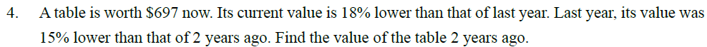











Let $n be the value of the table 2 years ago
n
$$×$$
$$−$$
$$×$$
(1
$$−$$
18%)
(1
15%)
$$=$$
697
n
$$×$$
$$×$$
0.85
0.82
$$=$$
697
n
$$=$$
1000
$$∴$$
2 years ago, the value of the table was $1000

Slide 6






















new
$$−$$
old
% change
New price of the car
$$=$$
$$×$$
100 %
old
$$=$$
$$×$$
(1
$$−$$
$$×$$
(1
$$−$$
8%)
$125000
15%)
$$×$$
$$×$$
$$=$$
$125000
0.85
0.92
$$=$$
$97750
new $−$ old
Percentage change
$$=$$
$$×$$
100%
old
Overall percentage change
97750 $−$ 125000
$$=$$
$$×$$
100%
125000
$$=$$
$−$ 21.8%

Slide 7
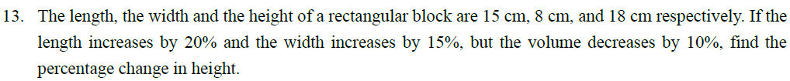













































Let n% be the percentage change in height
Old length
$$=$$
15
New length
$$=$$
15
$$×$$
(1
$$+$$
20%)
Old width
$$=$$
8
New width
$$=$$
8
$$+$$
(1
15%)
Old height
$$=$$
18
New height
$$=$$
18
$$×$$
(1
$$+$$
n%)
Old volume
$$×$$
18
New volume
$$=$$
New length
$$×$$
New width
$$×$$
New width
$$=$$
15
$$×$$
8
$$=$$
Old volume
$$×$$
(1
$$−$$
10%)
$$+$$
$$×$$
8
$$+$$
$$×$$
$$=$$
$$×$$
18
$$×$$
(1
$$−$$
10%)
$$×$$
(1
20%)
(1
15%)
$$+$$
15
15
18
$$×$$
(1
n%)
$$×$$
8
1.2
$$×$$
$$×$$
1.15
(1
$$+$$
$$=$$
n%)
0.9
n
$$=$$
$−$34.8
The percentage decrease in height is 34.8%

Slide 8
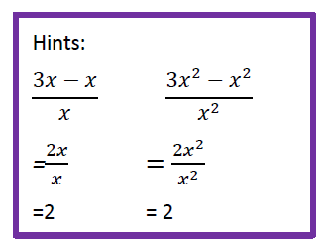
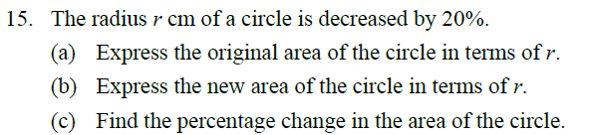

























(a)
$$=$$
2
2
Original area of the circle
$$π\text{r}$$
$$\text{cm}$$
(b)
New radius of the circle
(c)
Percentage change in the area of the circle
$$=$$
r
$$−$$
$$×$$
(1
20%) cm
2
0.64
$$π\text{r}$$
$$−$$
2
$$=$$
$$π\text{r}$$
$$=$$
$$×$$
100%
0.8r cm
2
$$π\text{r}$$
New area of the circle
$$=$$
$−$36%
$$=$$
$$π$$
2
2
(
0.8r) cm
$$=$$
2
2
0.64
$$π\text{r}$$
$$\text{cm}$$

Slide 9
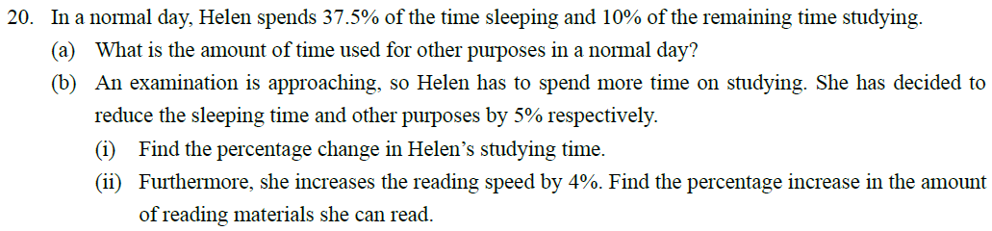



































(a)
Amount of time used for other purposes
2.625 $−$ 1.5
% change
$$=$$
$$×$$
100%
$$=$$
$$×$$
(1
$$−$$
37.5%)
$$×$$
(1
$$−$$
10%)
24
1.5
$$=$$
$$=$$
75%
13.5
hours
(bi)
Original amount of studying time
(bii)
Let x be the original rate of reading
$$=$$
$$×$$
(1
$$−$$
37.5%)
$$×$$
10%
% increase in the amount of reading materials she can read
24
$$=$$
1.5
hours
New amount of studying time
$$×$$
(1
$$+$$
4%)
$$−$$
1.5x
$$=$$
2.625
x
$$×$$
100%
$$−$$
(1
$$−$$
$$−$$
$$−$$
$$=$$
$$×$$
$$×$$
5%)
37.5%
$$×$$
(1
5%)
24
24
13.5
1.5x
$$=$$
2.625
$$=$$
82%
hours

Slide 10
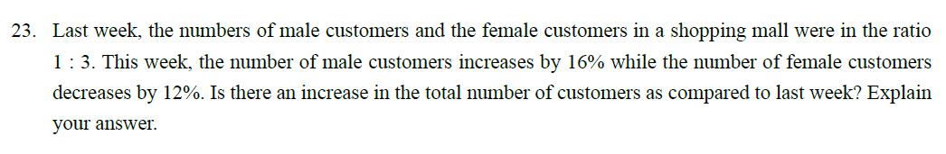























Let x be the total number of customers last week
$$∴$$
% change in the total number of customers
Last week,
1
0.95 x $−$ x
Number of male customers
x
$$=$$
$$=$$
0.25 x
$$=$$
$$×$$
100%
1$+$3
x
3
$$=$$
$−$5%
x
Number of female customers
$$=$$
$$=$$
0.75 x
1$+$3
This week,
$$∴$$
The total number of customers does not increase as compared to last week
Number of male customers
0.25 x
$$+$$
$$=$$
0.29 x
$$=$$
(1
16%)
Number of female customers
0.75 x
$$−$$
$$=$$
0.66 x
$$=$$
(1
12%)
Total number of customers $=$
0.29 x
$$+$$
0.66 x
$$=$$
0.95 x

Slide 11
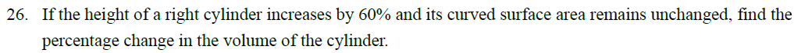




































Let r, h and R be the original base radius, original height and new base radius of the cylinder respectively,
$$=$$
$$\text{h}$$
(1
$$+$$
60%)
$$=$$
1.6 $\text{h}$
New height of the cylinder
$$∵$$
Original curved surface $=$new curved surface area
$$∴$$
$$\text{2}π\text{r}\text{h}$$
$$=$$
$$\text{2}π\text{R}\text{(}\text{1.6}\text{h}\text{)}$$
$$∴$$
% change in the volume of the cylinder
R
$$=$$
0.625 $\text{r}$
$$=$$
2
Original volume of the cylinder
$π\text{r}$ h
2
2
0.625
$$π\text{r} \text{h}$$
$$−$$
$$π\text{r} \text{h}$$
New volume of the cylinder
2
$$=$$
$$×$$
100%
$$=$$
$π\text{R}$ $\text{(}\text{1.6}\text{h}\text{)}$
2
$$π\text{r} \text{h}$$
2
$$=$$
$π\text{(}\text{0.625}\text{r}\text{)}$ $×\text{(}\text{1.6}\text{h}\text{)}$
2
0.375
$$π\text{r} \text{h}$$
$$=$$
$$−$$
$$×$$
100%
$$=$$
2
2
$\text{0.625}π\text{r}$ h
$$π\text{r} \text{h}$$
$$=$$
$−$37.5%

Slide 12
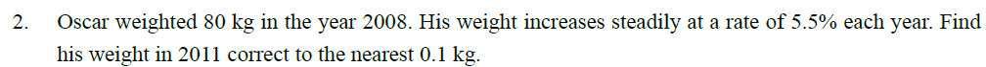











Oscar’s weight in 2011
Old value
$$=$$
80
3
$$=$$
80
$$×$$
(1
$$+$$
5.5%)
Change factor
$$=$$
5.5 %
$$=$$
93.9 kg (to the nearest 0.1 kg)
n
$$=$$
3
New value
$$=$$
x

Slide 13
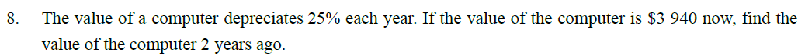










Let $y be the value of the computer 2 years ago
Old value
$$=$$
y
2
$y
(1
$$−$$
25%)
$$=$$
$ 3940
Change factor
$$=$$
$−$25 %
y
2
(
$$=$$
0.75)
3940
n
$$=$$
2
$$=$$
New value
y
7000 (cor. to 3 sig. fig.)
$$=$$
3940
$$∴$$
The value of the computer was $7000 2 years ago

Slide 14
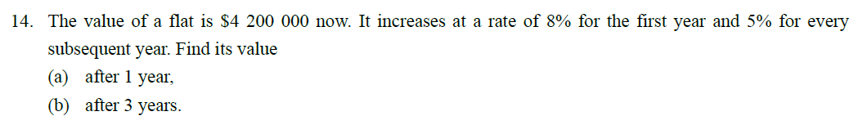













(a) Value of the flat after 1 year
$$=$$
$$×$$
(1
$$+$$
8%)
$ 4200000
$$=$$
$ 4536000
(b) Value of the flat after 3 years
$$×$$
$$+$$
2
$$=$$
$ 4536000
(1
5%)
$$=$$
$ 5000940

Slide 15
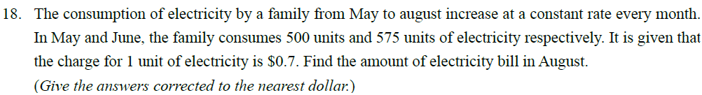











Let R% be the increase rate
575
$$=$$
500
(1
$$+$$
R%)
R
$$=$$
15
2
$$×$$
$$+$$
Amount of electricity bill in August $=$
$ 0.7
575
(1
15%)
$$=$$
$ 532

Slide 16
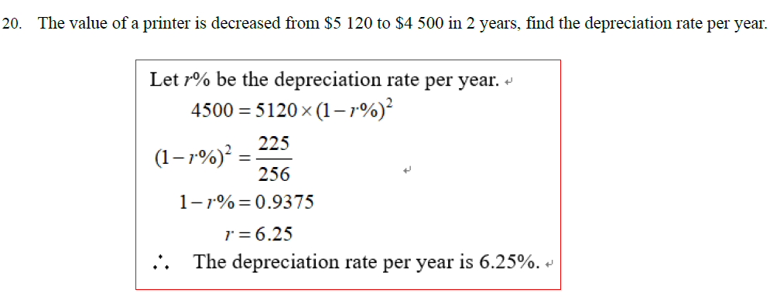













Let r% be the depreciation rate per year
2
4500
$$=$$
$$×$$
(1
$$−$$
r%)
5120
2
225
(1
$$−$$
r%)
$$=$$
256
1
$$−$$
r%
$$=$$
0.9375
r
$$=$$
6.25
$$∴$$
The depreciation rate per year is 6.25 %

Slide 17
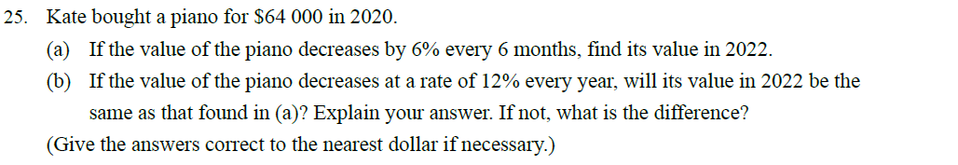

























(a)
Taking 6 months as a period,
(b)
Value of the piano in 2022
Number of periods from 2020 to 2022
$$−$$
2
$$=$$
$ 64000
$$×$$
(1
12%)
$$=$$
(2022 $−$2020)
$$×$$
2
$$=$$
$ 49561.6
$$=$$
4
$$≠$$
$ 49967.93
Value of the piano in 2022
$$∴$$
The value of the piano in 2022 will not be the same as that found in (a)
4
$$=$$
$ 64000
$$×$$
(1
$$−$$
6%)
The required difference
$$=$$
$ 49967.93
$$=$$
$ (49967.93 $−$ 49561.6)
$$=$$
$ 49968
(cor. to the nearest dollar)
$$=$$
$ 406
(cor. to the nearest dollar)

Slide 18
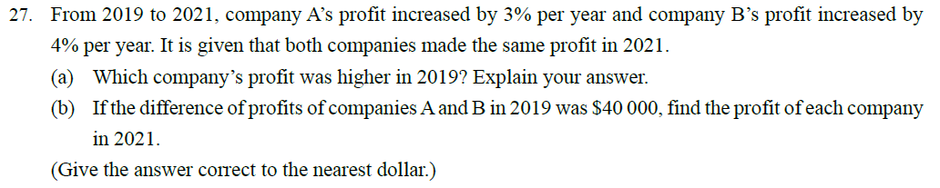



















(a)
Let $P be the profit of each company in 2021 and $P , $P be the profits of companies A and B in 2019 respectively
A
B
Number of periods
$$=$$
(2021 $−$2019)
$$=$$
2
P
2
P
2
$$×$$
(1
$$+$$
3%)
$$×$$
(1
$$+$$
4%)
P
$$=$$
P
$$=$$
P
P
A
B
$$∵$$
$$>$$
P
P
1.0609
1.0816
P
$$=$$
P
$$=$$
A
1.03
2
B
1.04
2
$$∴$$
Company A’s profit was higher in 2019
P
P
$$=$$
$$=$$
1.0609
1.0816

Slide 19














P
P
P
P
$$=$$
$$=$$
A
1.0609
B
1.0816
(b)
Difference of profits of companies A and B in 2019
P
P
$$=$$
$$−$$
40000
1.0609
1.0816
P
$$=$$
1
1
$$−$$
P
P
1.0609
1.0816
i.e.
40000
$$=$$
$$−$$
1.0609
1.0816
$$=$$
2217332
1
1
(cor. to the nearest integer)
40000
$$=$$
P
$$−$$
1.0609
1.0816
$$∴$$
The profit of each company in 2021 was $ 2217332

Slide 20



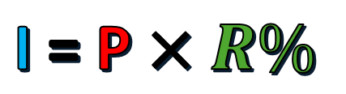
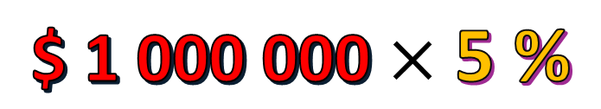




Interest Rate :
5 % per annum (p.a.)
(R%)
Simple Interest :
Principal
(P)
Interest
(I)
I = P $×R\%$
$$×T$$
Amount (A)
A = P $+ \text{I}$
A = P $+ \text{P} ×R\%×T$
A = P $(1+ R\%×T)$
$ 1 000 000
$ 50 000
$$\text{\$ 1 000 000}×\text{5 \%}$$
$ 50 000
$$\text{\$ 1 000 000}×\text{5 \%}$$

Slide 21







Percentage_interest
Simple interest
Principal
Rate
Year
Interest
Example
$1000
3%
5
x
Interest
$$×$$
$$=$$
Principal
Rate
$$×$$
Year
$$=$$
1000
$$×$$
$$×$$
3%
5
$$=$$
$150

Slide 22







Simple interest
Principal
Rate
Year
Interest
Example
x
3%
1
$60
x
$$×$$
$$×$$
$$=$$
$60
3%
1
0.03x
$$=$$
$60
x
$$=$$
2000
$$∴$$
The Principal is $2000.

Slide 23
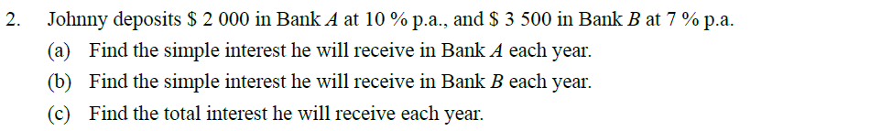















(a)
Simple interest he will receive in Bank A each year
$$=$$
$$×$$
$ 2000
$$×$$
10%
1
$$=$$
$200
(b)
Simple interest he will receive in Bank B each year
$$×$$
$$×$$
$$=$$
$ 3500
7%
1
$$=$$
$245
(c)
Total interest he will receive each year
$$=$$
$ (200 $+\text{245}\text{)}$
$$=$$
$445

Slide 24
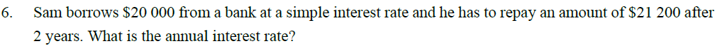

















Let r% be the annual interest rate
$$∵$$
A
$$=$$
P(
1 $+ \text{r}\text{\%}×\text{t}\text{)}$
$$∴$$
21200
$$=$$
20000
$$×$$
(1 $+ \text{r}\text{\%}×\text{2}\text{)}$
1 $+ \text{r}\text{\%}×\text{2}$
$$=$$
1.06
$\text{2} \text{r}\text{\%}$
$$=$$
0.06
$$\text{r}\text{\%}$$
$$=$$
0.03
r
$$=$$
3
$$∴$$
The interest rate is 3% p.a.

Slide 25

















Let t years be the required deposit period.
$$∵$$
A
$$=$$
P(
1 $+ \text{r}\text{\%}×\text{t}\text{)}$
$$∴$$
34880
$$=$$
32000
$$×$$
(1 $+\text{3}\text{\%}×\text{t}\text{)}$
1 $+\text{3}\text{\%}×\text{t}$
$$=$$
1.09
$$\text{0.03}\text{t}$$
$$=$$
1.09
$$\text{t}$$
$$=$$
3
$$∴$$
The required deposit period is 3 years.

Slide 26















$$∵$$
A
$$=$$
P(
1 $+ \text{r}\text{\%}×\text{t}\text{)}$
$$∴$$
19550
$$=$$
P
$$×$$
(1 $+\text{5}\text{\%}×\text{3}\text{)}$
19550
$$=$$
P
$$×$$
1.15
19550
P
$$=$$
1.15
P
$$=$$
17000

Slide 27
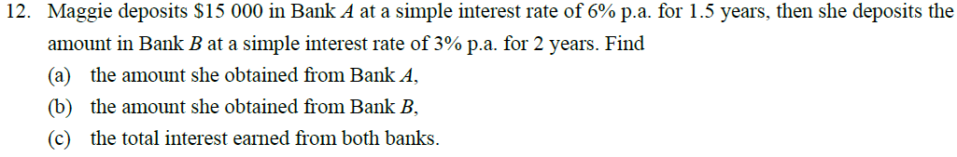

















(a)
Amount obtained from Bank A
$$=$$
$15000
$$×$$
(1 $+ \text{6}\text{\%}×\text{1.5}\text{)}$
$$=$$
$16350
(b)
Amount obtained from Bank B
$$=$$
$16350
$$×$$
(1 $+ \text{3}\text{\%}×\text{2}\text{)}$
$$=$$
$17331
(c)
Total interest earned from both banks
$$=$$
$ (17331 $−\text{15000}\text{)}$
$$=$$
$2331

Slide 28



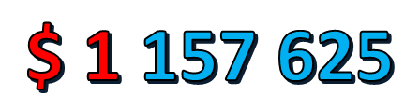
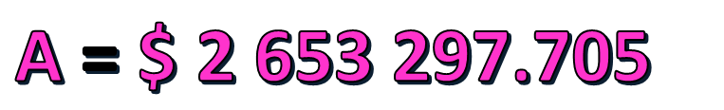
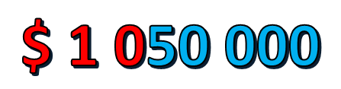
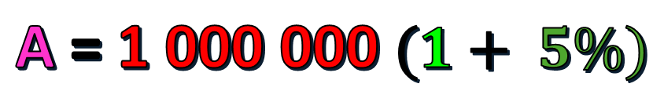
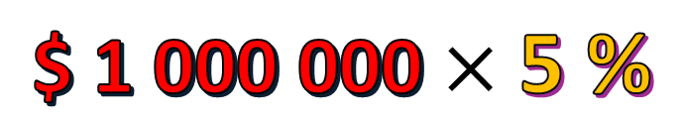
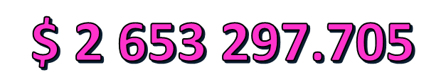
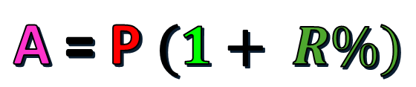
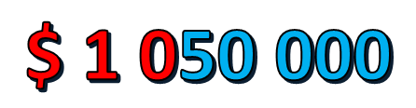

n
A
R
$$\text{\$ 1 000 000}×\text{5 \%}$$
$ 50 000
$$\text{\$ 1 0}\text{50} \text{000}$$
$$×\text{5 \%}$$
1 Yr
$ 52 500
2 Yr
$$\text{\$ 1 }\text{102} \text{500}$$
$$×\text{5 \%}$$
3 Yr
$$\text{\$ 1 }\text{157 625}$$
$$×\text{5 \%}$$
$$\text{\$ 1 0}\text{50} \text{000}$$
$ 1 000 000
20 Yr
$$\text{\$ 2 653 297.705}$$
$ 55 125
Compound Interest :
n
A = P $(1+ R\%)$
20
A = 1 000 000 $(1+ 5\%)$
A = $\text{\$ 2 653 297.705}$

Slide 29



Compound interest
Rate
Year
r%
n
$$×$$
t
A
$$=$$
P
(1
$$+$$
)
n
Amount
Number of times compound in 1 year
Principal

Slide 30
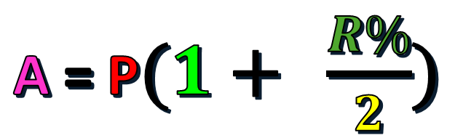

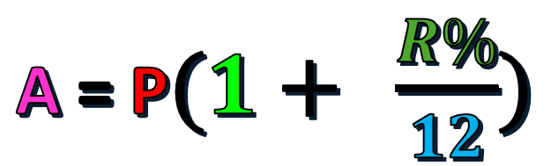
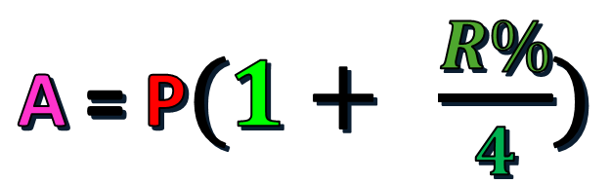
Compound Interest :
n = no. of period
Compounded
Yearly
t
A = P $(1+ R\%)$
t
x 2
Compounded
Half - Yearly
A = P$(1+ \frac{R\%}{2})$
Compounded
Quarterly
A = P$(1+ \frac{R\%}{4})$
t
x 4
Compounded
Monthly
A = P$(1+ \frac{R\%}{12})$
t x 12

Slide 31


















Compound interest
Principal
Rate
Year
Interest
Example
$10000
3%
2
x
t
Interest
$$×$$
$$+$$
$$−$$
$$=$$
Principal
(1
r%)
Principal
$$×$$
(1
$$+$$
2
$$−$$
$$=$$
10000
3%)
10000
$$=$$
$609
t
Amount
$$=$$
Principal
$$×$$
(1
$$+$$
r%)
$$×$$
(1
$$+$$
2
$$=$$
10000
3%)
$$=$$
$10609
Interest
Amount
$$−$$
Principal
$$=$$

Slide 32
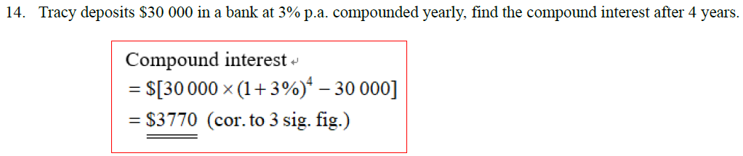








Compound interest
$$=$$
$ [30000
$$×$$
(1
$$+$$
4
$$−$$
30000]
3%)
$$=$$
$3770
(cor. to 3 sig. fig.)

Slide 33
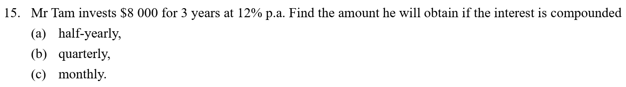



















(a)
The amount Mr Tam will obtain
$$×$$
12%
3
2
$$×$$
$$+$$
$$=$$
$ 8000
(1
)
2
$$=$$
$ 11300
(cor. to 3 sig. fig.)
(b)
The amount Mr Tam will obtain
(c)
The amount Mr Tam will obtain
$$×$$
12%
3
4
$$×$$
12%
3
12
$$×$$
$$+$$
$$=$$
$ 8000
(1
)
$$×$$
$$+$$
$$=$$
$ 8000
(1
)
4
12
$$=$$
$ 11400
(cor. to 3 sig. fig.)
$$=$$
$ 11400
(cor. to 3 sig. fig.)

Slide 34
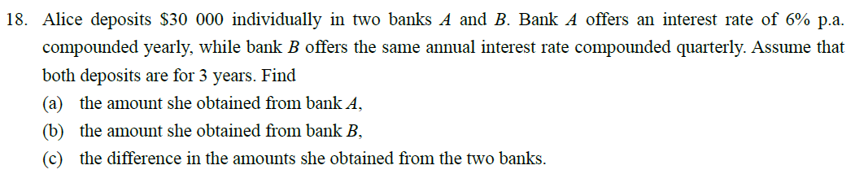
















(a)
Amount obtained from bank A
(c)
Difference in the amount
$ 30000
$$×$$
(1
$$+$$
3
$$=$$
6%)
$$≈$$
$ (35868.55
$$−$$
35730.48)
$$=$$
$ 35730.48
$$=$$
$ 138
(cor. to 3 sig. fig.)
(b)
Amount obtained from bank B
$$×$$
3
4
6%
$$×$$
$$+$$
$$=$$
$ 30000
(1
)
4
$$≈$$
$ 35868.55
$$=$$
$ 35900
(cor. to 3 sig. fig.)

Slide 35
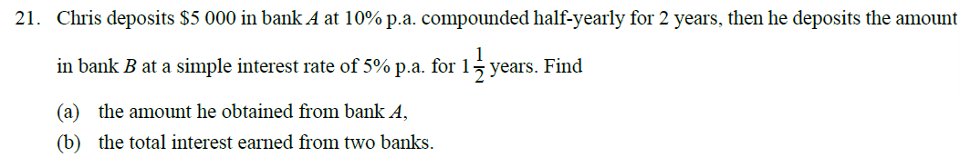





















(a)
Amount Chris obtained from bank A
(b)
Simple interest earned from Bank B
$$×$$
1
$$×$$
$$≈$$
$ 6077.53
5%
1
$$×$$
10%
2
2
2
$ 5000
$$=$$
$$×$$
$$+$$
(1
)
2
$$≈$$
$455.81
$$≈$$
$ 6077.53
Total interest earned in two banks
$$=$$
$ 6080
(cor. to 3 sig. fig.)
$$+$$
$$≈$$
$ [(6077.53 $−\text{5000}$)
455.81]
$$=$$
$ 1530
(cor. to 3 sig. fig.)

Slide 36
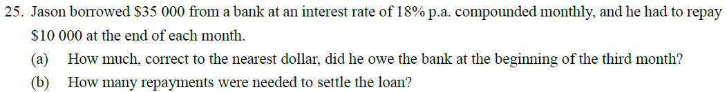























(a)
At beginning of 2nd month, amount he owed
18%
$$×$$
$$+$$
$$−$$
$ 10000
$$=$$
$ 35000
(1
)
At end of 4th month, amount he owed
12
$$=$$
$ 25525
18%
$$×$$
$$+$$
$$∴$$
At beginning of 3rd month, amount he owed
$$=$$
$ 6146
(1
)
12
18%
$$=$$
$ 6239
$$<$$
$ 10000
$$×$$
$$+$$
$$−$$
$ 10000
$$=$$
$ 25525
(1
)
12
$$=$$
$ 15908
4 payments were needed
(b)
At beginning of 4th month, amount he owed
18%
$$×$$
$$+$$
$$−$$
$ 10000
$$=$$
$ 15908
(1
)
12
$$=$$
$ 6146

Slide 37







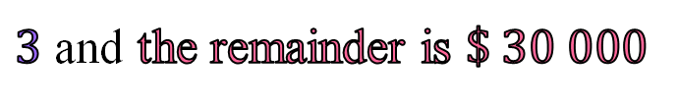





























Net chargeable income | Tax rate | Salary tax
On the first $\$ 50 000$ | $$2 \%$$ | $$\$ 1 000$$
On the next $\$ 50 000$ | $$6 \%$$ | $$\$ 3 000$$
On the next $\$ 50 000$ | $$10 \%$$ | $$\$ 5 000$$
On the next $\$ 50 000$ | $$14 \%$$ | $$\$ 7 000$$
Remainder | $$17 \%$$ | $\$ ?$
1
交稅似抽水,
抽到邊桶水?
$$1st$$
$$\$ 50 000$$
$$2nd$$
$$\$ 50 000$$
$$3rd$$
$$\$ 50 000$$
Miss Kwan’s total annual income for the year $2019/20$ is $\$ 300 000$.
If her salaries tax allowance is $\$ 120 000$, how much salaries tax should she pay
$$4th$$
$$\$ 50 000$$
Step 1 Covert total annual income into Net chargeable income
Net chargeable income
$$=$$
total annual income
Tax allowance
$$Remainder$$
$$−$$
$$=$$
$$−$$
$$\text{\$ }\text{12}\text{0 000}$$
$$\text{\$ 180 000}$$
$$\text{\$ }\text{30}\text{0 000}$$
Step 2 How many $\$ 50 000$ can be divided from Net chargeable income?
$$=$$
$3$ and the remainder is $\$ 30 000$
$$\text{\$ 180 000}÷\text{50 000}$$
$$\text{\$ 180 000}$$
$$=$$
$$\text{\$}$$
$$\text{50 000}$$
$$+ \text{50 000}$$
$$+ \text{50 000}$$
$$+ \text{30}\text{ 000}$$
(
)
Step 3 Calculation $Miss Kwan′s salaries tax payable$
$$=\text{50 000}×2\%$$
$$+\text{50 000}×6\%$$
$$+\text{50 000}×10\%$$
$$+ \text{30}\text{ 000}×14\%$$
$$=\$ 13 200$$

Slide 38
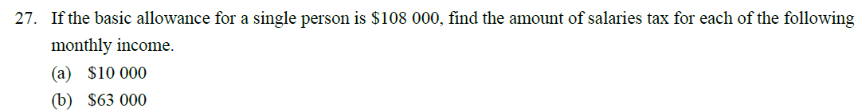






























(a)
Net taxable income
$$=$$
$ 10000
$$×$$
12
$$−$$
$ 108000
$$=$$
$ 12000
Salaries tax
$$=$$
$ 12000
$$×$$
2%
$$=$$
$ 240
(b)
Net taxable income
$$=$$
$ 63000
$$×$$
12
$$−$$
$ 108000
$$=$$
$ 648000
$$=$$
$(50000
$$+$$
50000
$$+$$
50000
$$+$$
50000
$$+$$
448000)
Salaries tax
$$=$$
$$×$$
$$+$$
$$×$$
17%
$50000
(2%
$$+$$
6%
$$+$$
10%
$$+$$
14%)
$ 448000
$$=$$
$16000
$$+$$
$76160
$$=$$
$92160

